Slide 1


INTERNSHIP PRESENTATION
Charity Outreach Campaign
ACADEMIC
INTERNSHIP
2026-27
Fundraising Intern | Pawzzitive Welfare Foundation
Keshav Kumar
25SCS1003001059
BTech CSE, 2nd Semester
Organization: Pawzzitive Welfare Foundation
Duration: 06th May 2026 – 07th June 2026
PAWZZITIVE WELFARE FOUNDATION • INTERNSHIP PRESENTATION

Slide 2
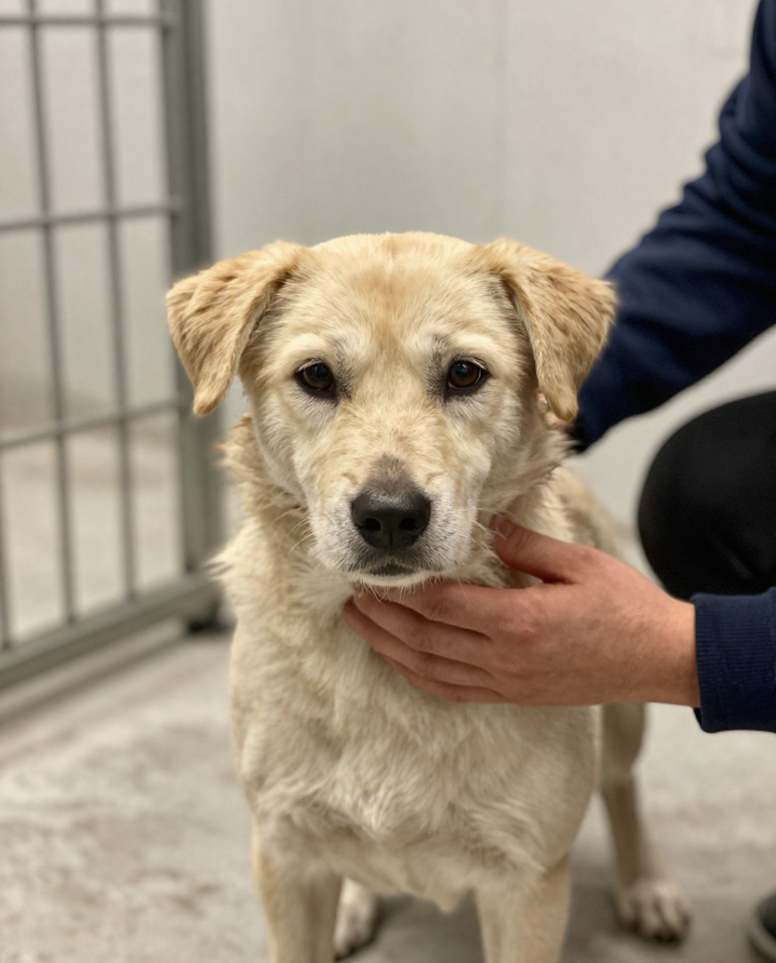
ORGANIZATION OVERVIEW
About Pawzzitive
Welfare Foundation
An animal welfare NGO dedicated to the rescue, treatment, food, shelter, and care of stray animals — connecting compassionate people with causes that need sustained action.
AKASH KUMAR
Managing Director
CIN: U85300HR2022NPL103894
Section 8, Companies Act 2013
C-428, Sushant Lok-1, Gurgaon, Haryana
PAWZZITIVE WELFARE FOUNDATION • INTERNSHIP PRESENTATION

Slide 3
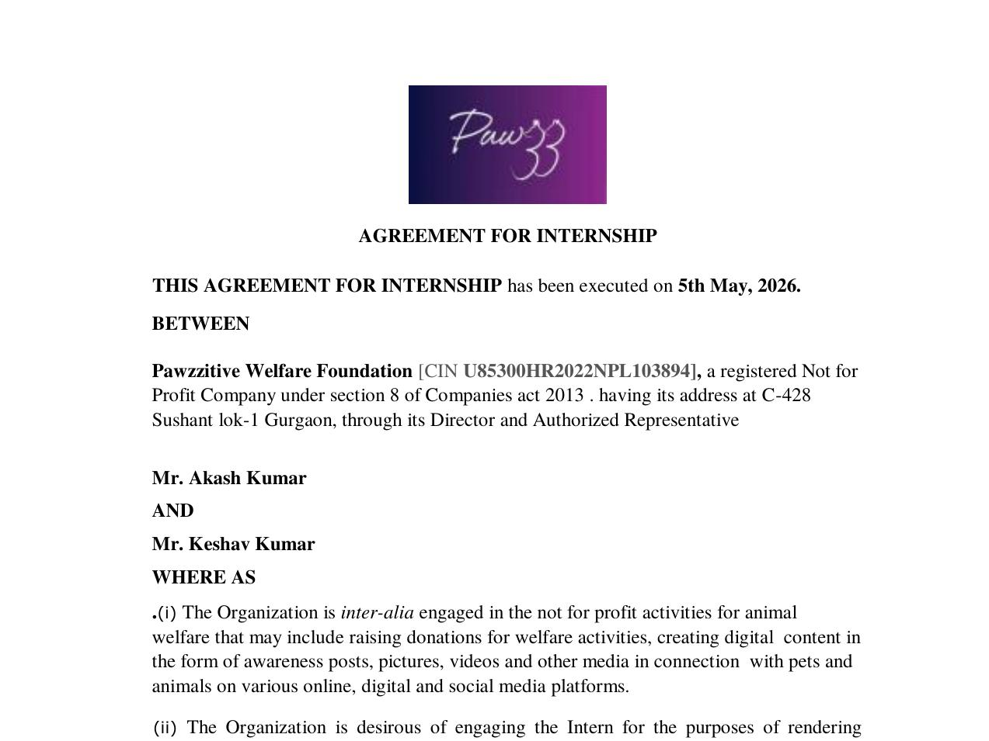
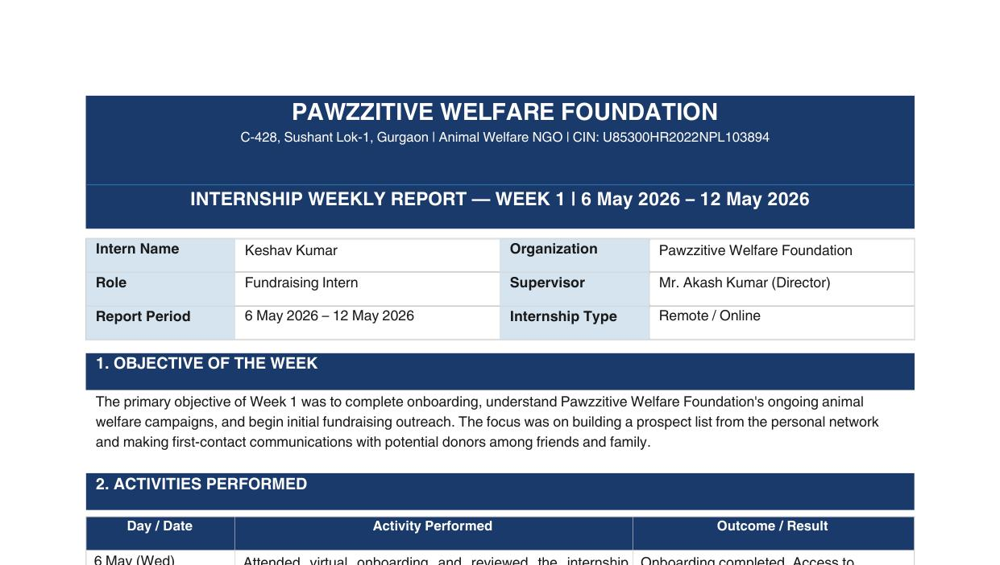
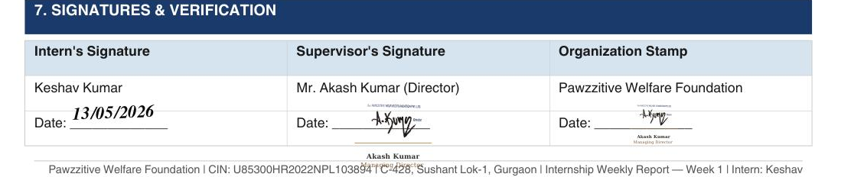
INTERNSHIP EXPERIENCE & PROOF
Documentation on Record
Pawzzitive Welfare Foundation — Fundraising Intern (Remote / Online)
VERIFIED DOCUMENT
VERIFIED DOCUMENT
Signed Internship Offer Letter
Weekly Progress Report
SIGNATURE VERIFICATION (WEEKLY REPORT)
PAWZZITIVE WELFARE FOUNDATION • INTERNSHIP PRESENTATION

Slide 4
ROLE & PURPOSE
Internship Scope
Fundraising Intern
Support Pawzzitive's animal welfare campaigns through online fundraising, donor outreach, and campaign coordination.
Animal Welfare Fundraising
DIGITAL
COMMUNICATION
DONOR
ENGAGEMENT
CAMPAIGN
COORDINATION
MODE
Remote / Online Internship
DURATION
One Month (06th May – 07th June)
PAWZZITIVE WELFARE FOUNDATION • INTERNSHIP PRESENTATION

Slide 5
FUNDRAISING PROGRESS
Weekly Timeline (Weeks 1–4)
Outreach and donations tracked week over week, from onboarding to the Rs. 600 milestone.
Week 2
Week 4
Rs. 154 Raised
Rs. 153 Raised
Outreach expanded to college peers and family — cumulative total reached Rs. 257.
Target achieved — cumulative Rs. 600 raised; full documentation submitted.
Week 1
Week 3
Rs. 103 Raised
Rs. 190 Raised
Onboarding completed; prospect list of ~20 contacts built from personal network.
College seniors and classmates engaged — cumulative total reached Rs. 447.
PAWZZITIVE WELFARE FOUNDATION • INTERNSHIP PRESENTATION

Slide 6
FIVE-STAGE PROGRESSION
Virtual Charity Drive Workflow
01
02
03
04
05
Orientation
Planning
Outreach
Engagement
Review
Mission, goals &
requirements
Channels, messaging
& audiences
Virtual platforms &
networks
Queries, participation
& follow-up
Progress, results &
learnings
PAWZZITIVE WELFARE FOUNDATION • INTERNSHIP PRESENTATION

Slide 7
KEY RESPONSIBILITIES
Work Performed & Supported
Aligned to the documented scope of the Virtual Charity Drive internship.
01
Promoting the drive through digital communication
02
Sharing fundraising information with prospective supporters
03
Supporting donor and participant engagement
04
Coordinating follow-ups and maintaining communication
05
Representing the Foundation's mission professionally
PAWZZITIVE WELFARE FOUNDATION • INTERNSHIP PRESENTATION

Slide 8
REFLECTION
Learning & Professional Development
Experience gained
Professional skills developed
Virtual fundraising and nonprofit outreach
Practical exposure to social-impact work
Understanding donor engagement
Communication and persuasion
Coordination and follow-up
Time management
Effective fundraising combines a clear cause, consistent communication, and trust.
PAWZZITIVE WELFARE FOUNDATION • INTERNSHIP PRESENTATION

Slide 9
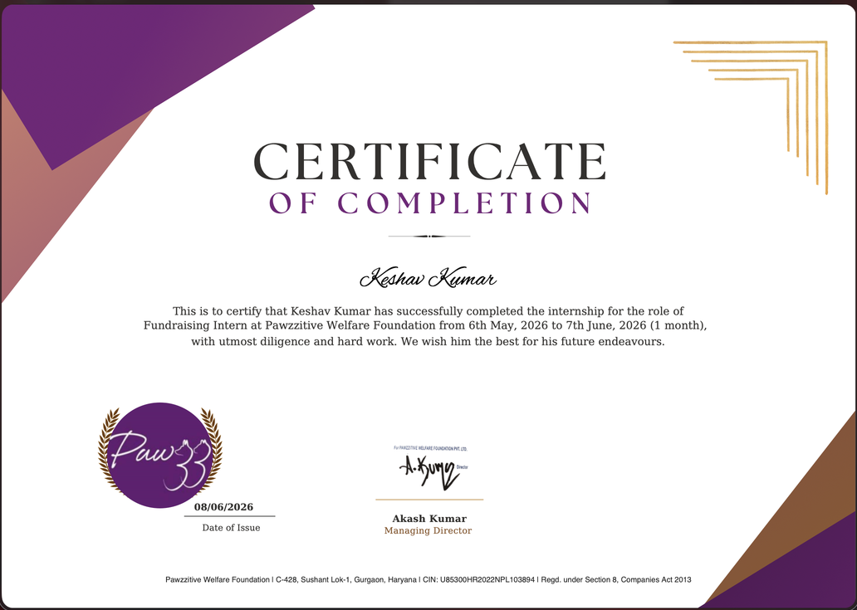
CERTIFICATE VERIFICATION
Internship Validated
Thank
You
PAWZZITIVE WELFARE FOUNDATION • INTERNSHIP PRESENTATION

